Slide 1

Library Management System
MPP Group 2
Issa Fikadu
Ashraf Elayed
Pat Adrian Limosnero

Slide 2
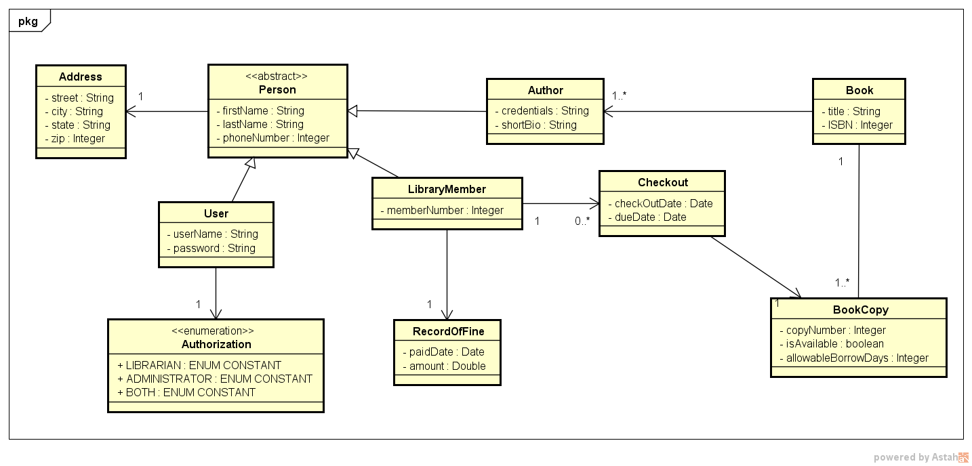
Class Diagram

Slide 3
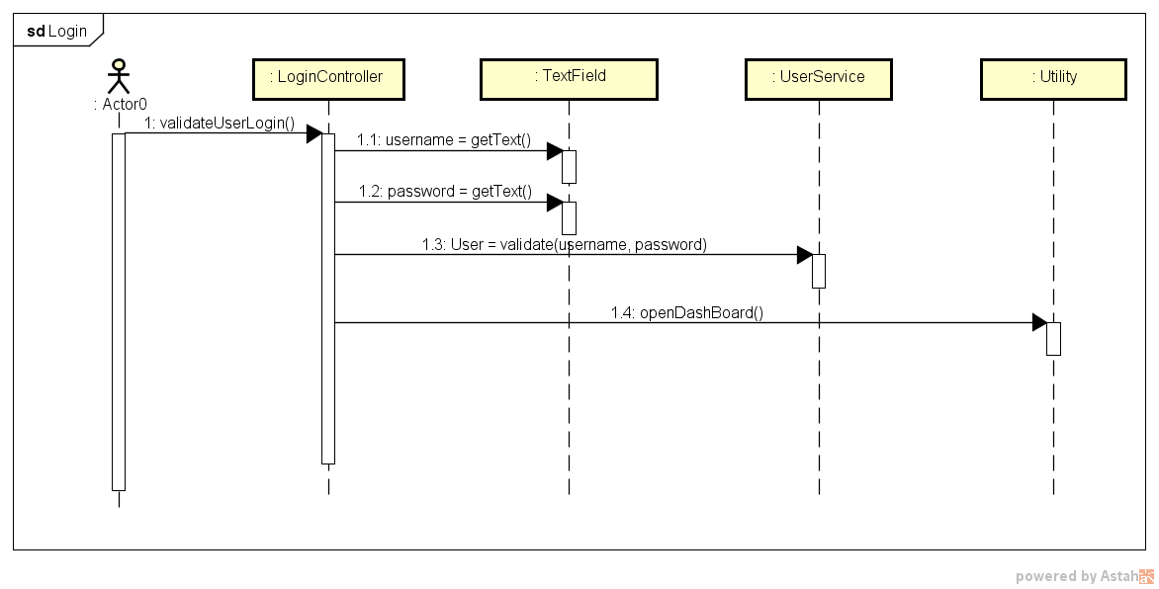
Sequence Diagram - Login

Slide 4
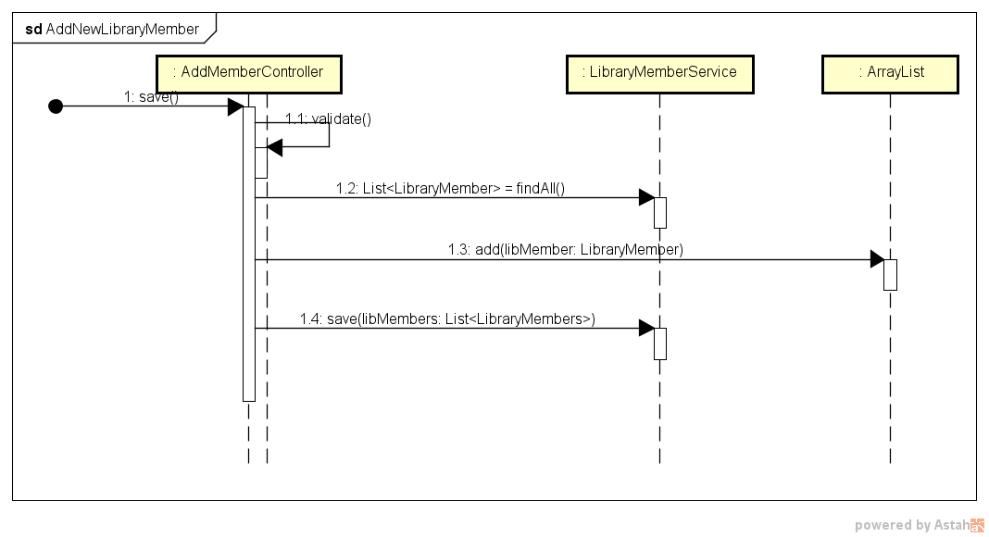
Sequence Diagram – Add New Library Member

Slide 5
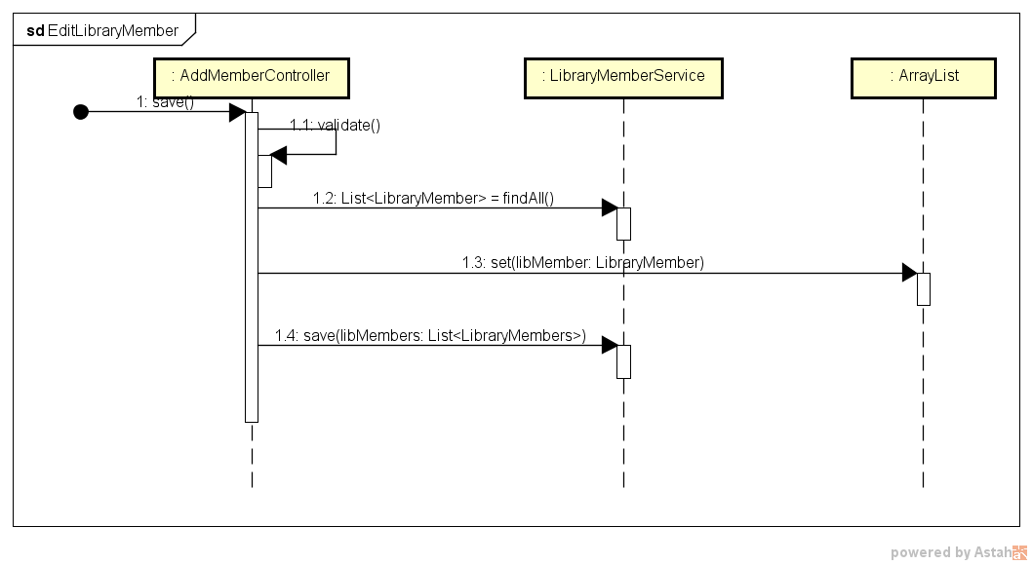
Sequence Diagram – Edit New Library Member

Slide 6
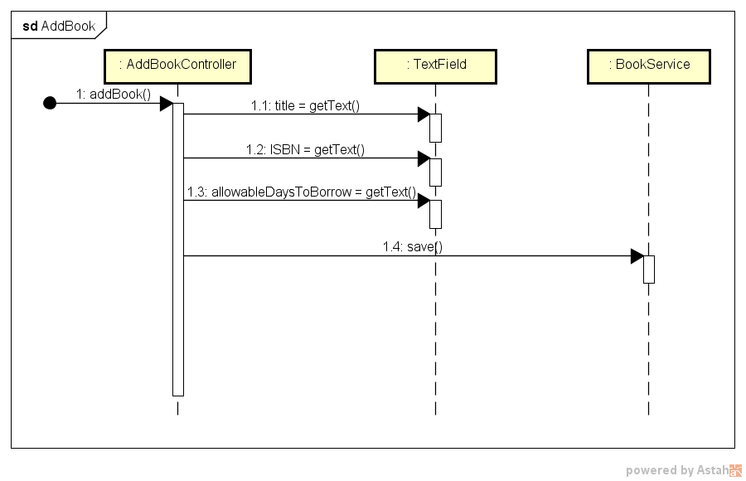
Sequence Diagram – Add Book

Slide 7
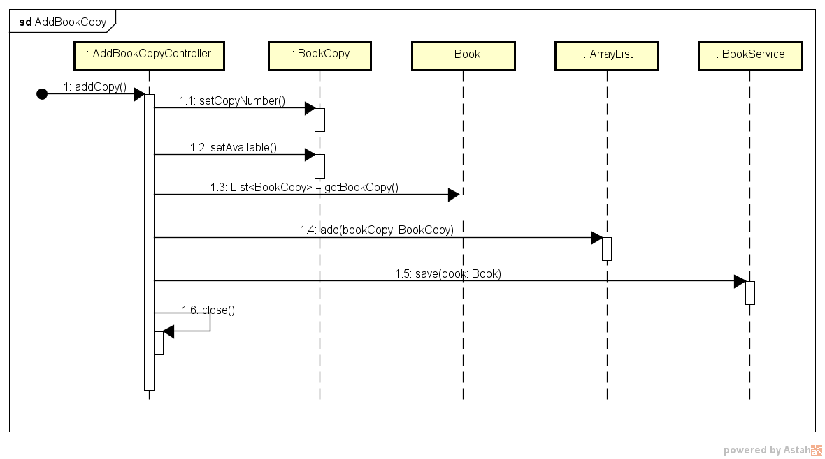
Sequence Diagram – Add Book Copy

Slide 8
Sequence Diagram – Check Out Book

Slide 9


Slide 10


